Slide 1
Week 5. Neural Networks: Learning
In Week 5, you will be learning how to train Neural Networks. The Neural Network is one of the most powerful learning algorithms (when a linear classifier doesn't work, this is what I usually turn to), and this week's videos explain the 'backpropagation' algorithm for training these models. In this week's programming assignment, you'll also get to implement this algorithm and see it work for yourself.
The Neural Network programming exercise will be one of the more challenging ones of this class.

Slide 2
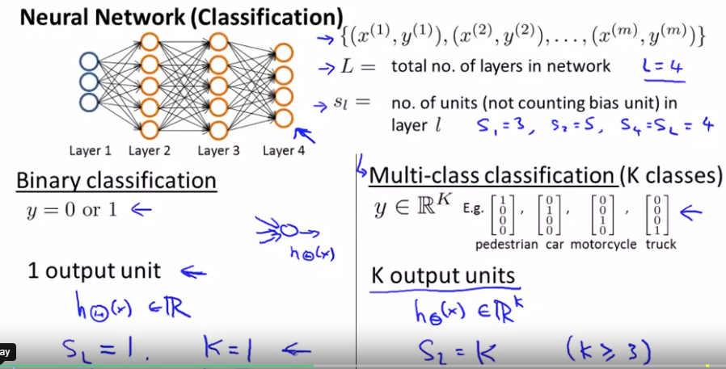
Cost function
In binary classif problem, we
Have 1 output unit (0 or 1), so
Sl=1
In multi-class classification,
We have k output units, sl=k

Slide 3
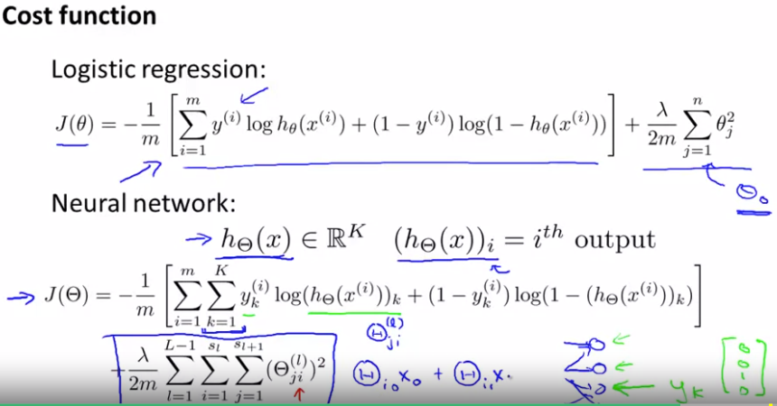
For classification problems
Cost function of neural nets
is similar to of logistic regr.
The difference in main
Part is only that we only sum
Over all outputs (when k>1)
Whereas for the regularization part for each layer we sum for all thetas in all units and layers
Outer sum is for all layers (exlc the 1st one); inner sum is for each element in theta matrix
N of cols in our current theta matrix is equal to N of nodes in our current layer (incl bias unit), N of rows in our current theta matrix is equal to N of nodes in the next layer (excl the bias unit). I does not refer to training example

Slide 4
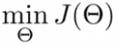
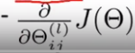
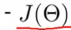
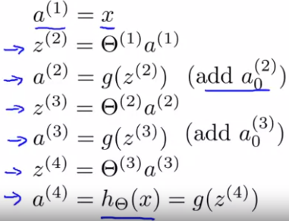
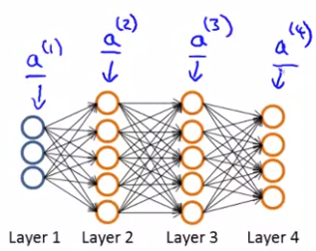
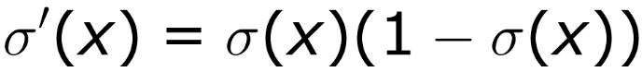
Backpropagation algorithm
For training neural network we need to train the parameters of network, that is find optimal parameter of theta that minimizes the cost function
So, for applying gradient descent, or any other adv optim algo we need and
First, we need to compute the forward propagation
Derivative of sigmoid activation f is:

Slide 5
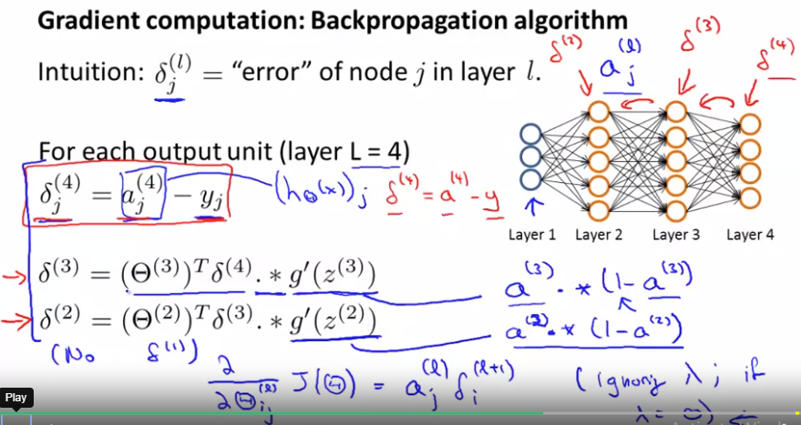
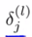
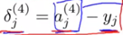
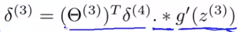
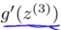
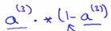
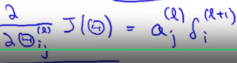
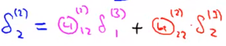
For backpropagation algo, we
Introduce term, which is error
Of node j in layer l
For final layer it is obvious, we
Just subtract from value of
Prediction actual outputs (y)
For other layers we have the
Following expression:
which means, e.g for layer 3, we multiply weights linking layer 3 and 4 by error vector in 4 (we take transpose of theta as it’s normal form was used for forward propag with bias unit) and piecewise multiply it with derivative function (sigmoid) evaluated at z’s, that is theta(2)*a2 but before applying sigmoid function. =
Having done that, that is computing errors in each layer (backpropagating errors) we can find derivatives of theta at each layer, which is

Slide 6
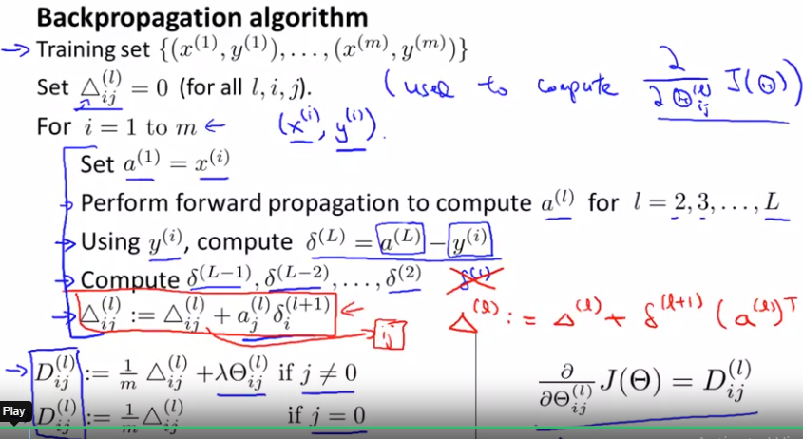
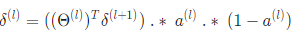
This fancy triangle (delta) is
Used for the accumulation of
Partial derivatives of cost func
wrt to each theta.
That is it sums the partial
Deriv over all training examples
So algorithm is like following
We set initial partial deriv
Term (triangle) to 0
Then for each training example
We perform forward propagation.
Having done forward propagation, we then calculate the error in final output layer and backpropagate the errors till the 2nd layer and calculate the partial derivatives for each theta
We repeat these for all the training examples and once finished we get D term which is partial derivative of cost function wrt to each theta. It is different for bias unit due to regular.

Slide 7
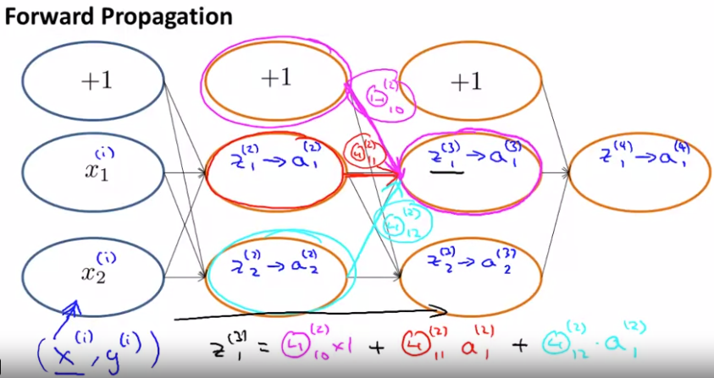
So we do FP and BP for each sample and then repeat these steps for next sample, that is:
Backpropagation is neural network terminology for minimizing our cost function, just like what we were doing with gradient descent in logistic and linear regression, the goal is to minimize the cost function J, using an optimal set of parameters in theta
Neat and clear demonstration of
Forward propagation

Slide 8
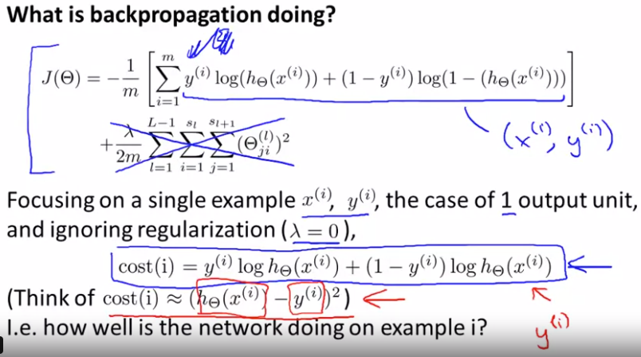
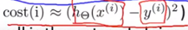
Let’s look closer at backprop
On an example of 1 training examp
And ignoring regularization
Then for cost function we get
The following expression
We can think of the expression
Above as
Just it is the case that for logistic
Regression usual cost function does not work
So, overall the cost function helps us to judge how well the network is doing on example i

Slide 9
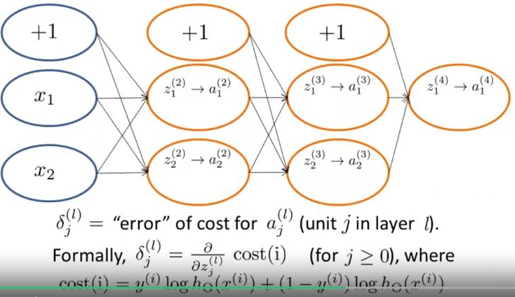
Useful intuition is that backprop is comput
these delta (error) ij terms
We can think of these as the measure of
error of the activation value that we got for
unit j in the lth layer
More formally, the delta terms actually are
partial derivatives wrt to zlj’s, that Is the weight
sum of inputs that Were comput these z terms
Partial derivatives with respect to these
things of the cost function
Concretely, the cost function is a function of the label y and of the value of h(x).
If we go inside the neural net and just change zlj values a little bit, then that will affect the values neural net is outputting, thus changing the value of cost function
So, they(p.d) are measure of how much we would like to change the neural nets weights in order to affect these intermediate values of the computation. So as to affect the final output of the neural net h(x) and therefore affect the overall cost

Slide 10
Backpropagation in practice

Slide 11
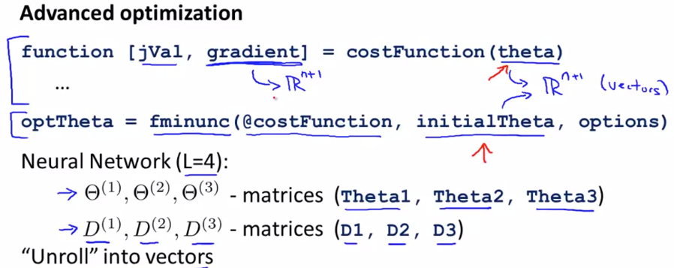
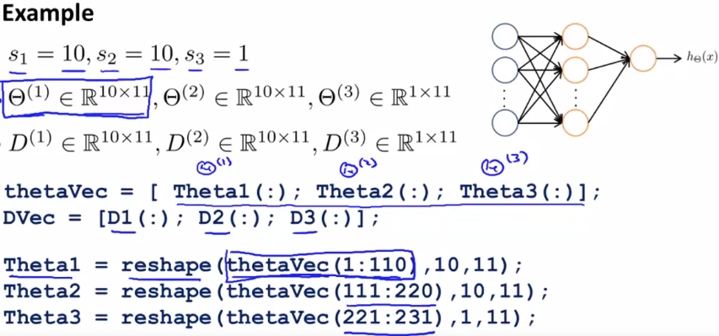
For training neural networks we
Can use advanced optim routines
To use them, we need to pass
Cost function, gradient and initial
Theta
However, the problem we face
When we apply these optimization
Routines to neural nets is that gradient and theta are not vectors but matrices, so we need to unroll them before being able to pass them to those routines
Let’s say we have 3 layer neural net 10-10-1
Then we will have corresponding theta and D
Matrices, with sizes shown on the right
We can use following 2 functions to unroll
And roll again matrices to vectors and back

Slide 12
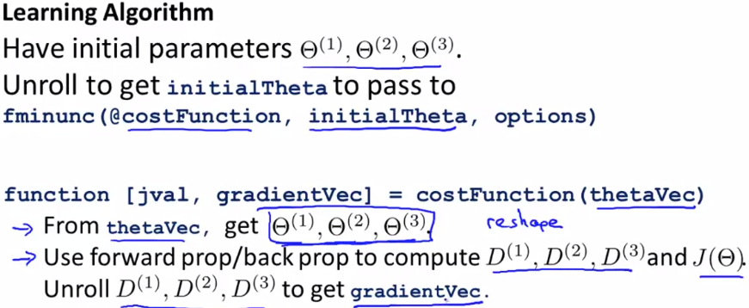
For using advanced optimization
Routines we need to pass to routine
1)Cost function 2) gradient 3)init_theta
1st we unroll theta matrix and get
Theta vector to pass as input
2nd we roll again to theta matrix
To ease the computation of backprop
Forward prop to compute cost function and gradient matrices D1, D2, D3
As a final step we should unroll D1, D2, D3 to get vector of gradients to pass to optimization algorithm
So built-in functions in matlab/octave allow us to go back and forth between matrices and vectors depending on our needs

Slide 13
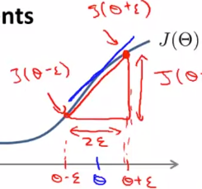
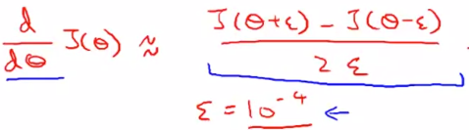
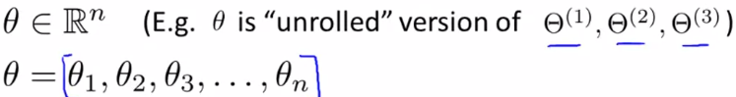
Implementation of backprop is involved and although we might get an implementation where J-cost function is decreasing at every iteration, and it may seem like everything is fine, we may have subtle bugs that worsen the performance
There is an idea of gradient checking that may help to combat these problems, and is very useful to use when implementing any reasonably complex algorithm
Numerical estimation of gradients
(central diff)
If we consider theta as vector (say unrolled)
We can approximate derivative of cost funct.
Wrt to any theta, using central difference

Slide 14
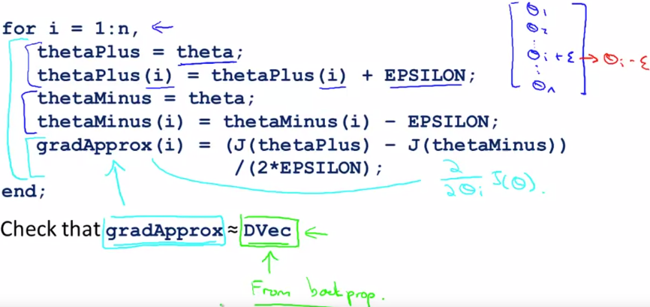
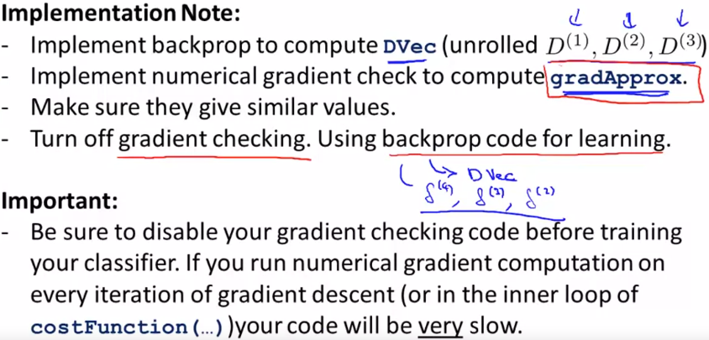
On the right is the implementation
Of approximate gradient vector
Once we do it we get a vector of
Approximate gradients and then we
Can compare it to Dvec vector from
Backprop and they should be similar
To up to few decimal places
So, procedure for implementing backpop:
Implement backprop to compute Dvec
Implement numerical grad check
Make sure their values are aligned
Turn off gradient checking before training
As approx. grad calc is very slow compared to
Optimized backprop algo

Slide 15
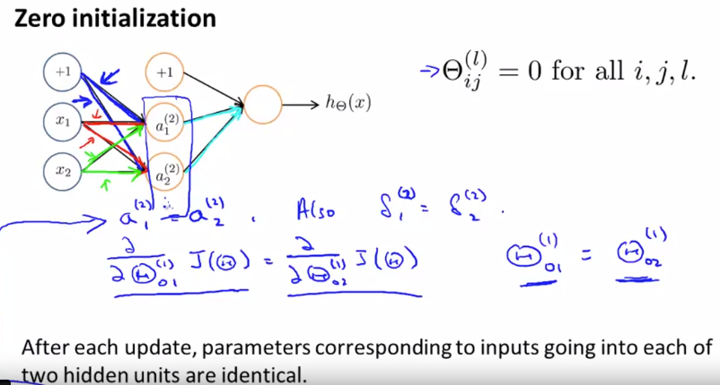
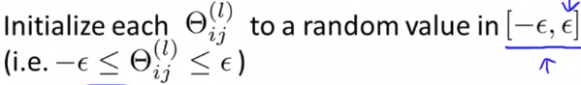

Random initialization
For running gradient descent and adv optimization algos we need to pass in initial values for theta
While, passing 0’s was acceptable for LR and LOG regression, for neural nets it does not work
With 0 initialization, the values of nodes
In hidden units take the same values, and
As deriv are also equal they take again
Same values after each iteration, thus they
Cannot represent interesting functions as
All nodes compute the same function
(redundant features- as if we have only feature in each layer). So we need to break the symmetry and take random values around 0

Slide 16
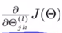
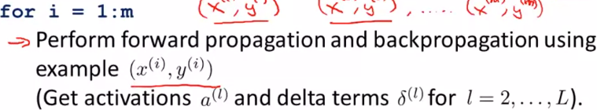
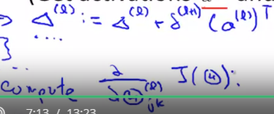
Putting everything together for training a neural network
Picking a neural net architecture.
1) Number of input units by default equals to dimension of features x(i) and
2) number of output units-number of output classes (if 3 remember to convert the output to vectors [1;0;0]; [0,1,0]; [0,0,1].
3) N of hidden layers usually picked as 1, and if >1 usually try to pick same number of hidden units in every layer (usually the more the better) and try to pick number of hidden units comparable to input feature size
Training neural net.
Randomly initialize weights (symmetry breaking). Values around 0
Implement forward propagation to get activations, for any x(i) to output y’s
Implement code to compute cost function
Implement backprop to compute partial derivatives
In last step we loop through m training examples and perform forward and backw prop using each training example and get activations a(l) and delta terms(l) for l=2,..L and next triangle terms, that is partial derivatives

Slide 17
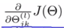
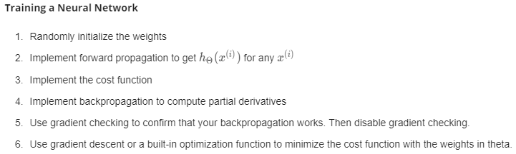
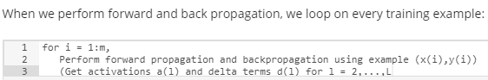
5) Use gradient checking to compare computed derivative terms using backprop vs using numerical estimate of gradient of
Once we ensured backprop is working correctly we should then disable grad. checking code
6) Use gradient descent or advanced optimization method with backprop to try to minimize cost function as function of parameters theta by computing derivative terms
It is worth to note that cost function for neural net is non-convex function, so that we may not get to the optimum point, however, with using gradient descent or any adv optimization algo will get us to reasonable local minima

Slide 18
Big delta_l (between particular layers) that is matrix of gradients should be of the same size as theta_l
Small delta_l (error term) should be of the same size as a_l
So, overall small delta is error term in each layer, whereas big delta is partial derivative term
Practical Tip: When performing gradient checking, it is much more efficient to use a small neural network with a relatively small number of input units and hidden units, thus having a relatively small number of parameters.

